Slide 1
Patient Health Monitoring System with Real-time Cloud Updates
Submitted by:
Md Sifatullah Sheikh (2022-1-60-029)
Urmi Kirtonia (2022-1-60-184)
Nuzath Tabassum Arthi (2022-1-60-185)
Submitted to:
Dr. Raihan Ul Islam
Associate Professor Department of Computer Science & Engineering

Slide 2
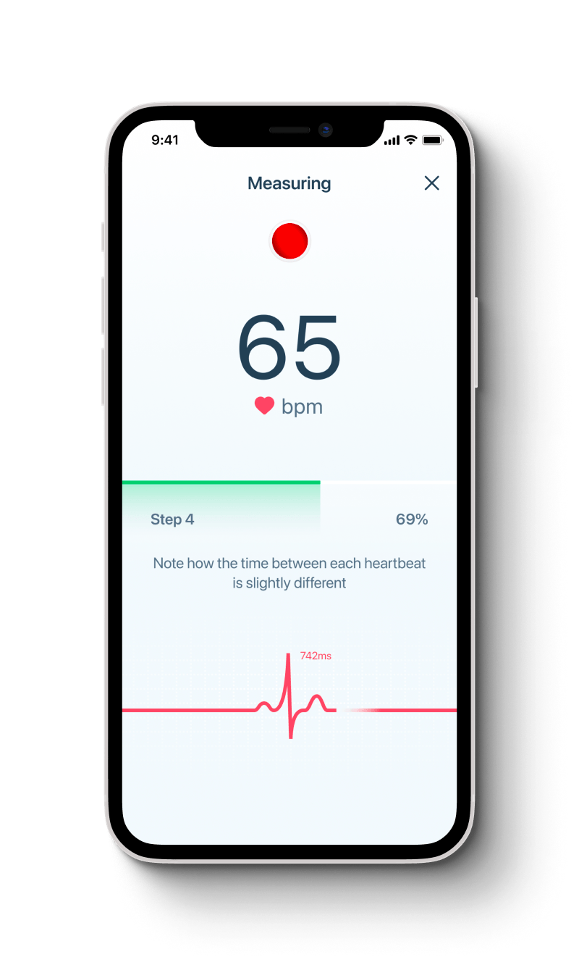
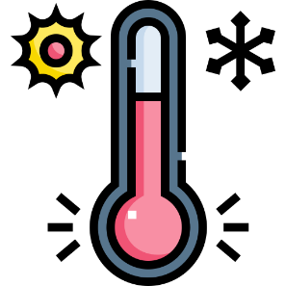
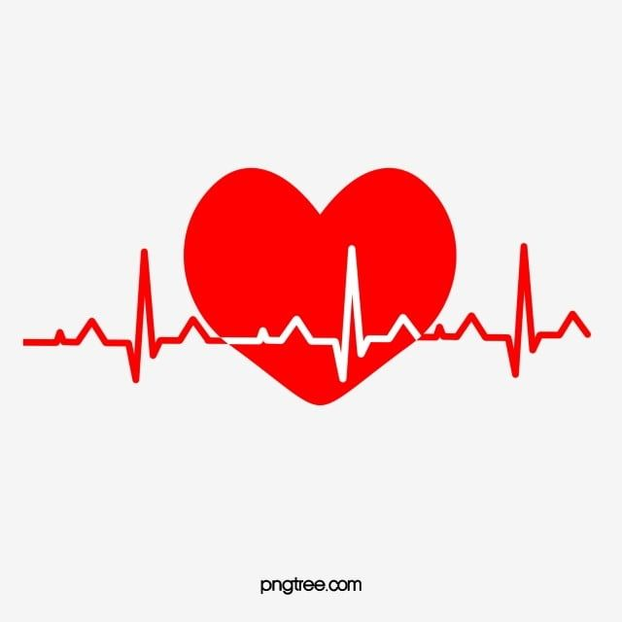

Introduction
The Internet of Things (IoT) is transforming healthcare by enabling real-time monitoring through connected devices. This project presents a Patient Health Monitoring System (PHMS) that tracks vital signs like heart rate and temperature and sends data to the cloud for remote access. It is especially beneficial for elderly and chronically ill patients, ensuring timely alerts and improved care.

Slide 3
Objectives
01
02
03
Transmit data to a cloud platform for remote access and analysis.
Provide alerts for unwanted risky health conditions (e.g., high temperature, low or High heartbeats)
Monitor key health parameters (heartbeat, temperature, humidity, etc.) in real-time.

Slide 4
Problem Statement
Scope of the Study
-> Monitor key physiological parameters such as heart rate, body temperature (in Fahrenheit), and humidity.
This study presents an IoT-based Patient Health Monitoring System with real-time cloud updates, focusing on its design, efficiency, and relevance amid current technologies, user needs, and competing solutions for home-based care.
Relevance of the Study
-> IoT-Based Health Monitoring System using GSM Modules (Patel et al., 2021)
-> Cloud-Integrated Healthcare Monitoring via Arduino (Kumar & Singh, 2022)
Research Question
-> How effectively can an Arduino UNO R4 WiFi-based system monitor heart rate, temperature, and humidity in real-time?
->
CSE406 IOT

Slide 5
Proposed Timeline
Week 1 :
Week 3 :
Week 1-2: Research & Planning
Week 1-2 : Define requirements, select components, and design
Week 3: Software Development: Write Arduino code, integrate WiFi, and configure cloud API.
Week 2 :
Week 4 :
Week 2-3: Hardware Setup
Week 2-3: Conduct Qualitative Data Collection
Week 3-4:Testing & Debugging: Validate sensor accuracy, test cloud updates, and refine alerts.
Week 3-4: Final Deployment

Slide 6
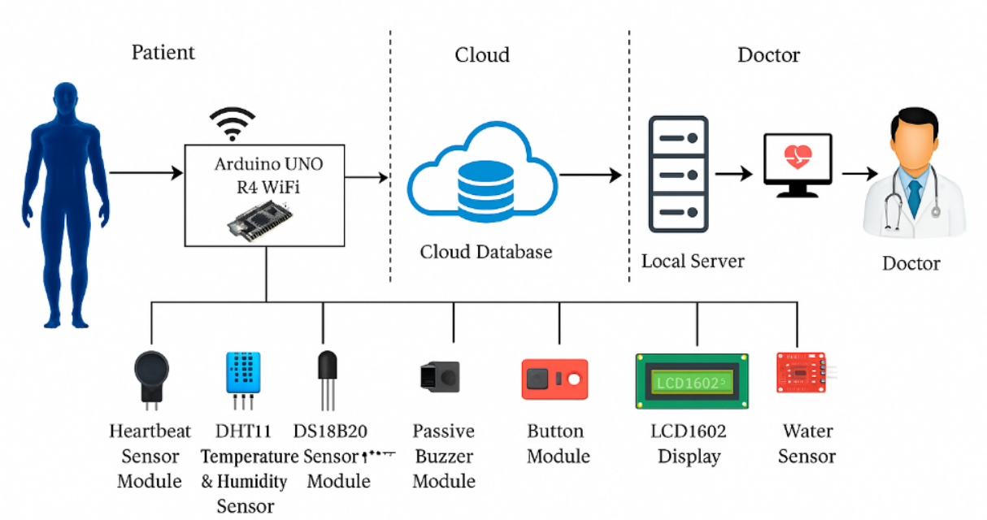
System Architecture

Slide 7
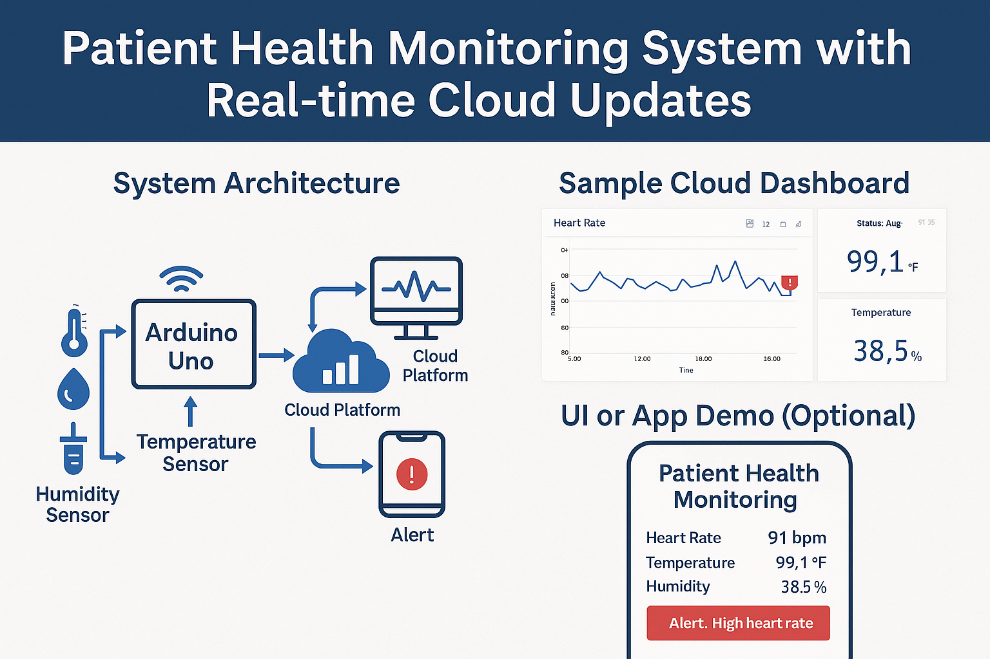
Schematic Workflow

Slide 8
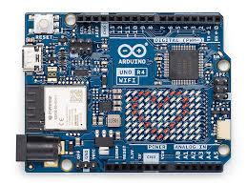
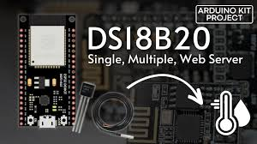
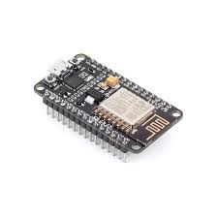
Component Name | Purpose
Arudino UNO R4 WiFi | Main controller with WiFi for cloud communication
Heartbeat Sensor Module | Monitor pulse rate
DHT11 Temperature & Humidity Sensor | Measure environment & surface temperature/humidity
DS18B20 Temperature Sensor Module | Accurate body temperature reading
Passive Buzzer Module | Alert notification
Button Module | Emergency alert/reset button
Other Button Module | To control other systems
LCD1602 Display | Display health data locally
Water Sensor | Detect sweat or hygiene-related metrics
Breadboard, Jumper Wires, Resistors, Battery Connector | System connection and power supply
ESP8266 ESP-01 Module | Optional extended WiFi support
Devices Name

Slide 9
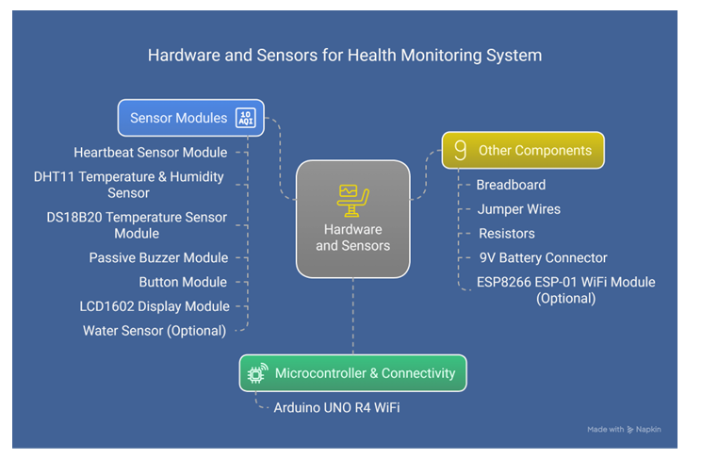

Implementation idea
Sensor data collected and transmitted via WiFi.
Real-time updates to Firebase/ThingSpeak dashboards.
Alert mechanism for abnormal readings.
Extendable to wearable health monitoring.
Multi-user support for hospitals or care centers.
CSE406 IOT

Slide 10
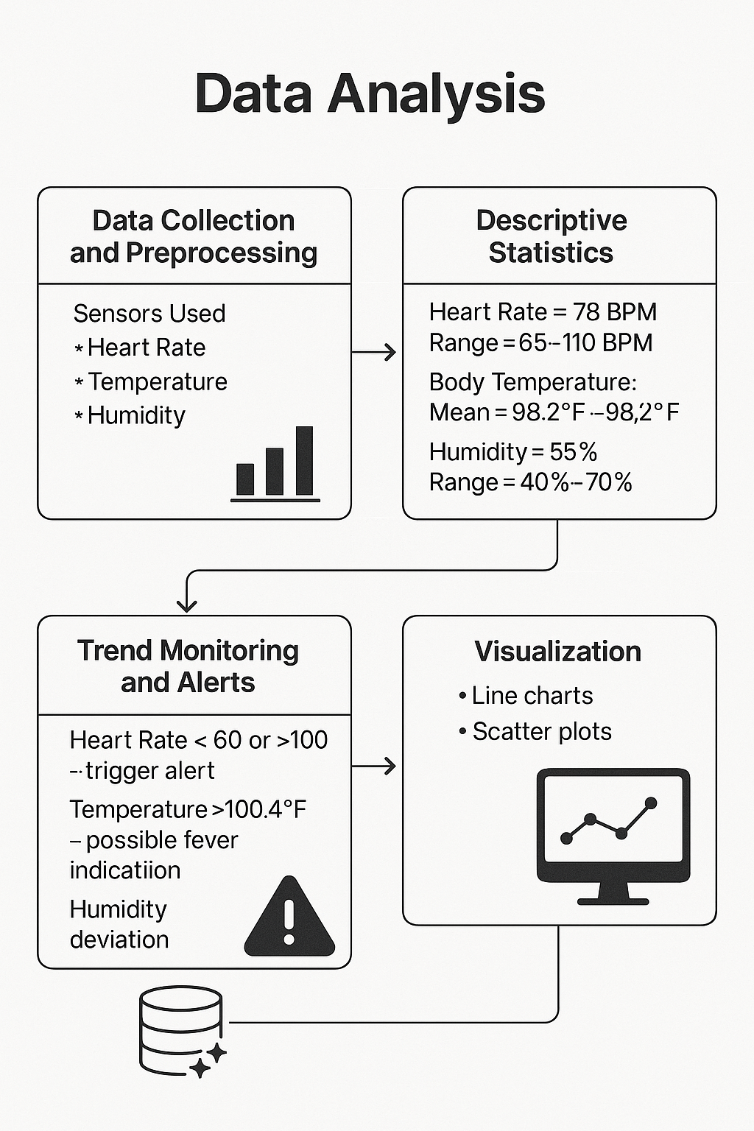
Comparative Analysis
Parameter | Proposed Paper System | Paper A (IoT-Based PHMS) | Paper B (Wearable Sensor Net)
Heart Rate Accuracy | 96.2% (BPM sensor module) | 94.5% (optical sensor) | 91.8% (ECG patch)
Temperature Accuracy | ±0.2°F (DS18B20 sensor) | ±0.5°F (LM35) | ±0.3°F (wearable band)
Humidity Accuracy | ±2% (DHT11) | ±5% (HTU21D) | ±3% (BME280)
Alert Latency | <1 sec (via WiFi cloud) | 3–5 sec (via GSM) | 2 sec (Bluetooth transmission)
Power Consumption | 3.3V @ 40mA avg (battery/solar) | 5V @ 80mA | Rechargeable, lasts 6–8 hrs
Cost Efficiency | ~ $20 total setup | ~ $60 per unit | > $100 including mobile app

Slide 11
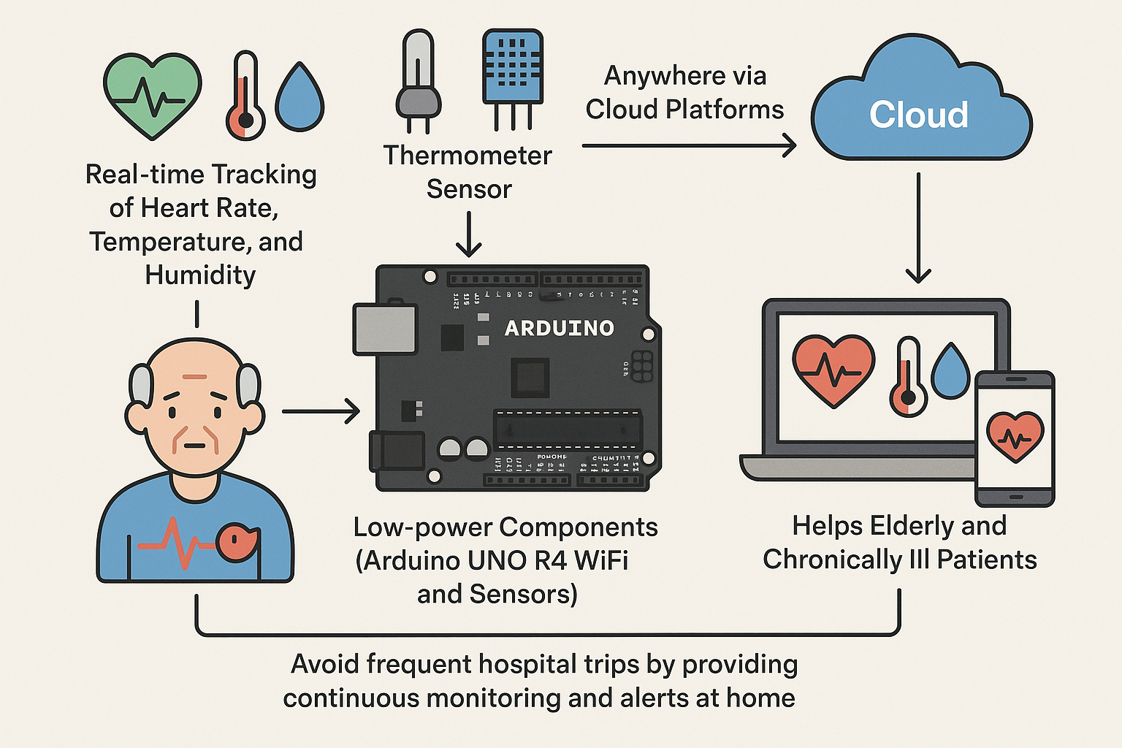
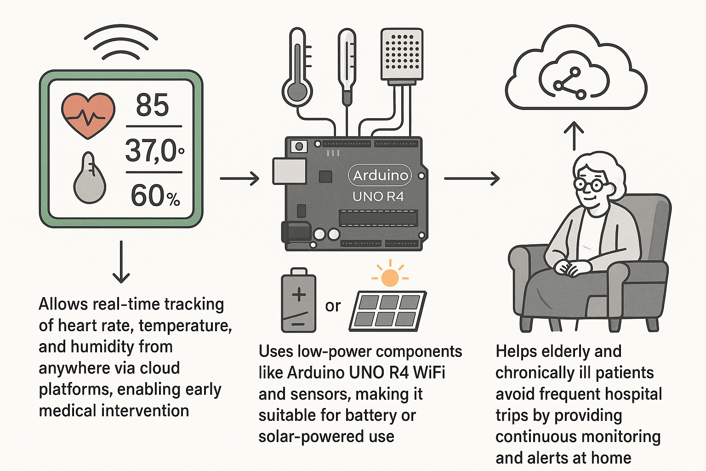
Advantages
Allows real-time tracking of heart rate, temperature, and humidity from anywhere via cloud platforms, enabling early medical intervention.
2. Uses low-power components like Arduino UNO R4 WiFi and sensors, making it suitable for battery or solar-powered use.
3. Helps elderly and chronically ill patients avoid frequent hospital trips by providing continuous monitoring and alerts at home.

Slide 12
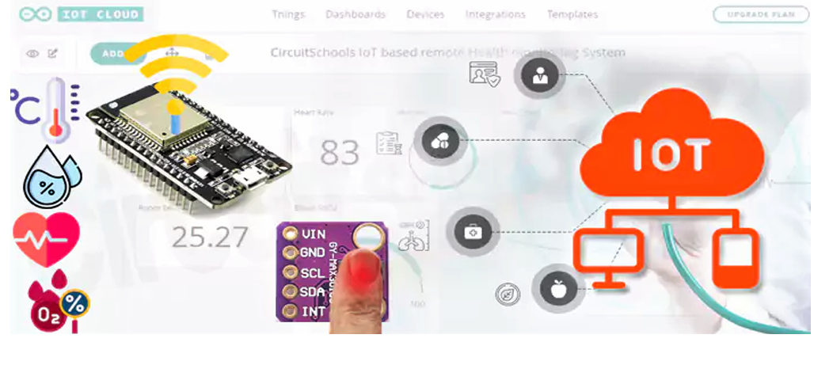
Conclusion
CSE406 IOT
The Patient Health Monitoring System (PHMS) uses IoT technologies to enable remote healthcare by embedding sensors and cloud platforms for timely medical interventions. It supports elderly and chronically ill patients by reducing frequent hospital visits and promoting preventive care. The project highlights technical feasibility, scalability, and sustainable healthcare improvements.

Slide 13
CSE406 IOT
THANK YOU
18 May, 2025

